Slide 1
Unit – IV
Network Security Application
Authentication Applications: Kerberos – X.509 Authentication Service – Electronic Mail Security –PGP – S/MIME - IP Security- Policy, Encapsulating Security Payload, Combining Security Associations, Internet Key Exchange, Authentication Header.

Slide 2
1.Authentication Applications
Kerberos is an authentication service developed as part of Project Athena at MIT.
An open distributed environment in which users at workstations wish to access services on servers distributed throughout the network.
Three threats exists:
One user pretend to be another and operates from a workstation.
A user may alter the network address of a workstation.
A user may eavesdrop on exchanges and use a replay attack.
In any of these cases, an unauthorized user may be able to gain access to services.

Slide 3
Kerberos
Kerberos provides a centralized authentication server whose function is to authenticate users to servers and servers to users.
Kerberos relies exclusively on symmetric encryption, making no use of public-key encryption.
Two versions of Kerberos are in common use. Version 4 & Version 5.
Three approaches to security can be envisioned:
- Individual client workstation has to be assured on the identity of its user or users - user identification (ID).
- Require that client systems authenticate themselves to servers.
- but trusts the client system concerning the identity of its user.
- Require the user to prove his or her identity for each service invoked. Also require that servers prove their identity to clients.

Slide 4
Requirements of Kerberos
Secure – Safe from Eavesdroppers.
Reliable – Service should be readily available.
Transparent – Authentication be simple but convenient.
Scalable - capable of supporting large numbers of clients and servers.
Version 4 of Kerberos makes use of DES, in a rather elaborate protocol, to provide the authentication service.
In an unprotected network environment, any client can apply to any server for service.

Slide 5
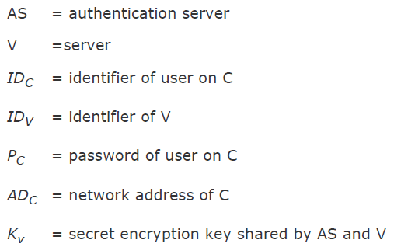
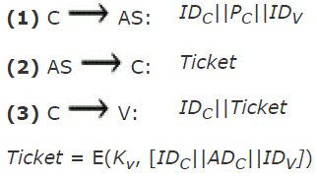
Kerberos Version 4
The obvious security risk is that of impersonation.
An opponent can pretend to be another client and obtain unauthorized privileges on server machines.
Servers must be able to confirm the identities of clients who request service.
An authentication server (AS) that knows the passwords of all users and stores these in a centralized database. Also maintains client(C)/server(V) interactions.

Slide 6
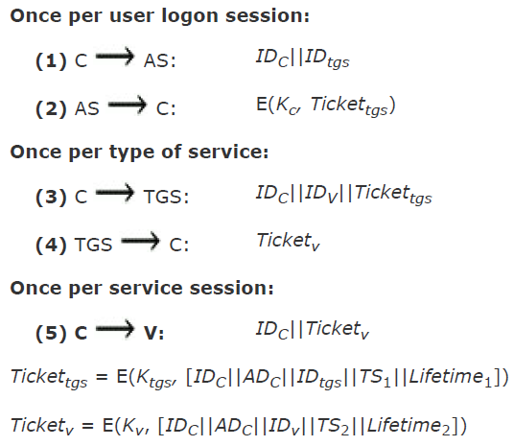
Kerberos Version 4
The second problem is that an eavesdropper could capture the password and use any service accessible to the victim.
We introduce a scheme for avoiding plaintext passwords and a new server, known as the ticket-granting server (TGS).

Slide 7
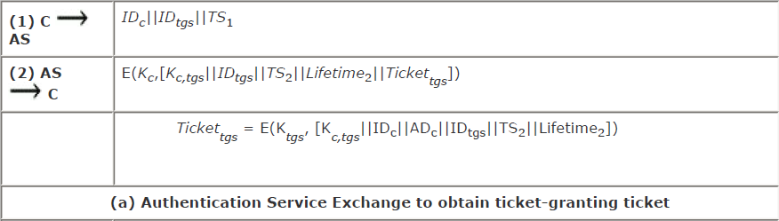
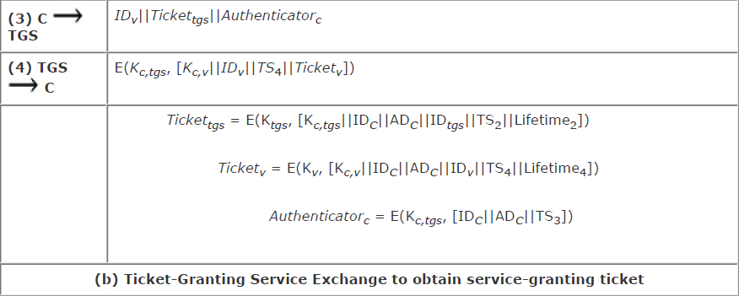
V4 Authentication Dialogue

Slide 8
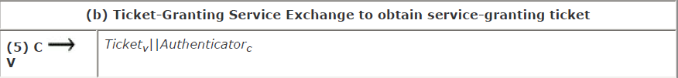
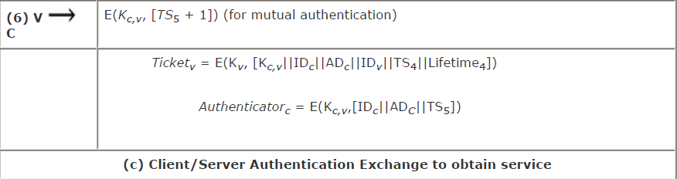
V4 Authentication Dialogue

Slide 9
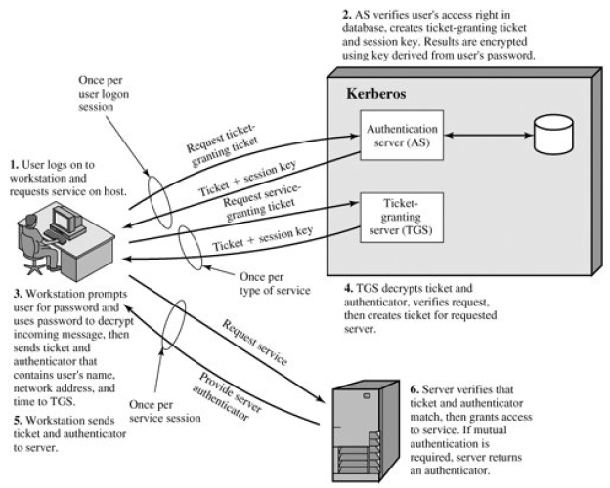
Kerberos Realm & Multiple Kerberi

Slide 10
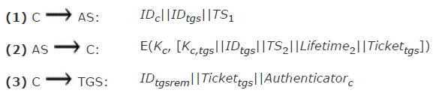
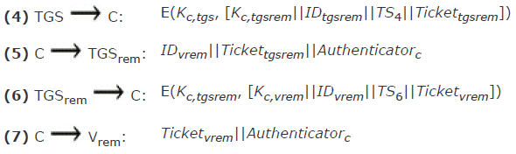
Overall Exchanges of Kerberos

Slide 11
Environmental Shortcomings & Technical Deficiencies in V4
Environmental Shortcomings
Encryption System Dependence
Internet Protocol Dependence
Message Byte Ordering
Ticket Lifetime
Authentication Forwarding
Interrealm Authentication
Technical Deficiencies
Double Encryption
PCBC Encryption
Session Keys
Password Attacks

Slide 12
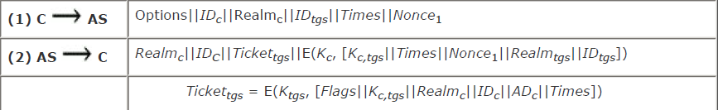
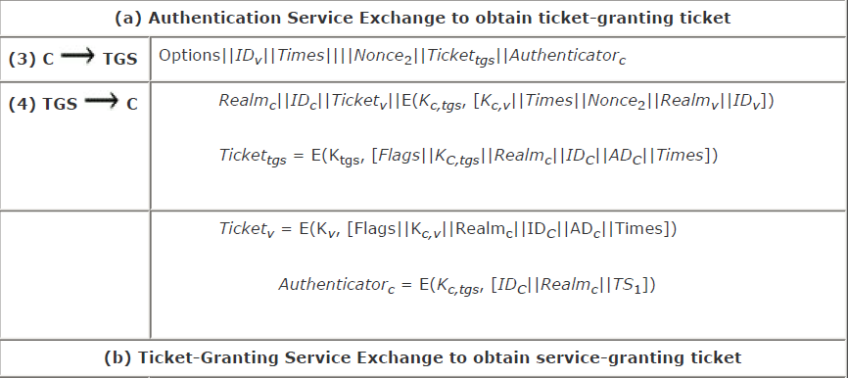
Kerberos V5 Authentication Dialogue

Slide 13
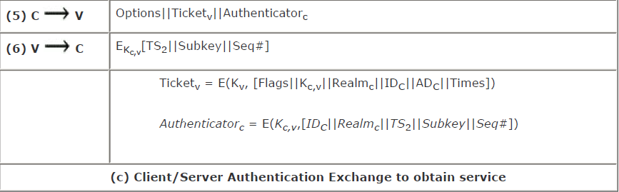
Kerberos V5 Authentication Dialogue
Authentication service exchange. Message (1) is a client request for a ticket granting service ticket. This includes the ID of the user and the TGS, realm, options, times and Nonce.
Message(2) returns a ticket-granting ticket, identifying information for the client, and a block encrypted using the encryption key based on the user's password.

Slide 14
Message Exchange in V5
Includes the session key to be used between the client and the TGS, times specified in message (1), the nonce from message (1), and TGS identifying information.
Message(3) includes an authenticator, a ticket, and the name of the requested service, requested times and options for the ticket and a nonce.
Message (4) has the same structure as message (2), returning a ticket plus information needed by the client, the latter encrypted with the session key now shared by the client and the TGS.
In message (5), the client may request as an option that mutual authentication is required.

Slide 15
2.X.509 Authentication Services
ITU-T recommendation X.509 is part of the X.500 series of recommendations that define a directory service.
Distributed set of servers that maintains a database of information about users.
Mapping from user name to network address, other attributes and information about the users.
X.509 defines a framework for the provision of authentication services by the X.500 directory to its users.
the certificate structure and authentication protocols defined in X.509 are used in a variety of contexts.
X.509 was initially issued in 1988. Revised later at 1993. A third version was issued in 1995 and final revision in 2000.

Slide 16
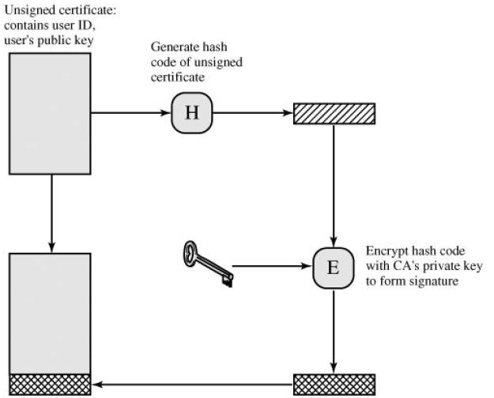

Public Key Certificate
Certificate Authority

Slide 17
Certificates
Version – Mentions the version used.
Serial Number - an integer value unique for a issuing CA.
Signature Algorithm Identifier - algorithm to sign the certificate.
Issuer Name - X.500 name of the CA created & signed this certificate.
Period of Validity - First & last date for the certificate.
Subject Name - Name of the user.
Subject’s Public key Information - public key of user + identifier for the algorithm used.
Issuer Unique Identifier - an optional bit string field to mention CA.
Subject Unique Identifier - an optional bit string field to mention the subject.
Extensions - set of one or more extension fields.
Signature – Covers all other fields of the certificate.

Slide 18
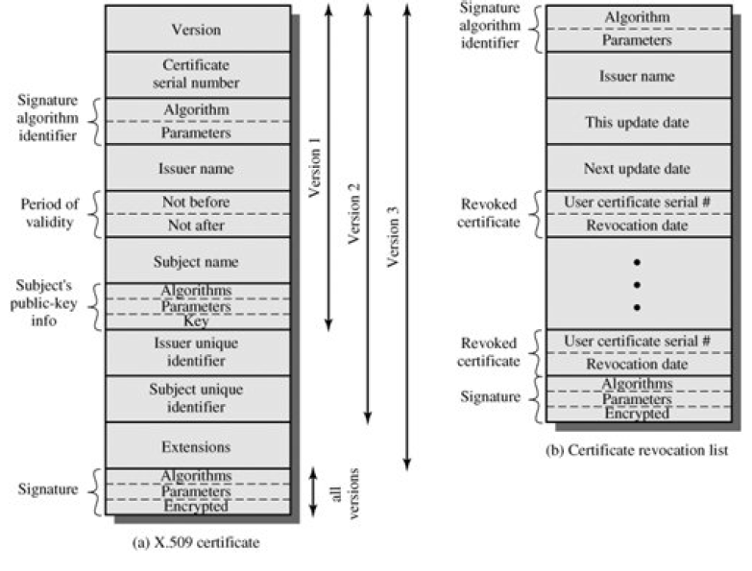
X.509 Formats

Slide 19
X.509 Authentication Procedures
X.509 also includes three alternative authentication procedures that are intended for use across a variety of applications.
All these procedures make use of public-key signatures.
One-Way Authentication
One way authentication involves a single transfer of information from one user (A) to another (B), and establishes the following:
1.The identity of A and that the message was generated by A
2.That the message was intended for B
3.The integrity and originality (it has not been sent multiple times) of the message

Slide 20
Two & Three Way Authentication
Two Way Authentication
In addition to the three elements just listed, two-way authentication establishes the following elements
4.The identity of B and that the reply message was generated by B.
5.That the message was intended for A.
6.The integrity and originality of the reply.
Three Way Authentication
7. A final message from A to B is included, which contains a signed copy of the nonce r_{B}.
The intent of this design is that timestamps need not be checked.
Both nonces are echoed back by the other side, each side can check the returned nonce to detect replay attacks.

Slide 21
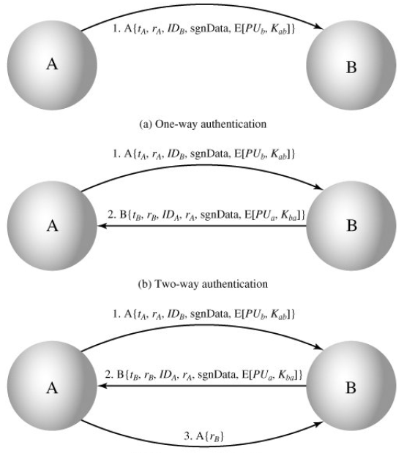
X.509 Strong Authentication Procedures

Slide 22
X.509 Key & Policy Information
Authority Key Identifier - Identifies the public key to be used to verify the signature on this certificate or CRL.
Subject Key Identifier - Identifies the public key being certified. Useful for subject key pair updating.
Key Usage - Indicates a restriction imposed as to the purposes for which, and the policies under which, the certified public key may be used.
Private-key Usage period - the period of use of the private key corresponding to the public key.
Certificate policies - used in environments where multiple policies recognized for supporting, together with optional qualifier information.
Policy mappings - Used only in certificates for CAs issued by other CAs.

Slide 23
Certificate Subject & Issuer Attributes
Subject alternative name - Contains one or more alternative names for the subject.
Issuer alternative name - Contains one or more alternative names for the issuer.
Subject directory attributes - Conveys any desired X.500 directory attribute values for the subject of this certificate.
Certificate Path Constraints
Basic Constraints - Indicates if the subject may act as a CA.
Name Constraints - Indicates a name space within which all subject names in subsequent certificates in a certification path must be located.
Policy Constraints - may require explicit certificate policy identification or inhibit policy mapping.

Slide 24
3.E-Mail Security
A.Pretty Good Privacy
Phil Zimmermann's PGP provides a confidentiality and authentication service that can be used for electronic mail and file storage applications.
Selected the best available cryptographic algorithms as building blocks.
Application that is independent of os and processor and that is based on a small set of easy-to-use commands.
Made the package and its documentation, including the source code, freely available.
Agreement with Viacrypt to provide a fully compatible, low-cost commercial version of PGP.

Slide 25
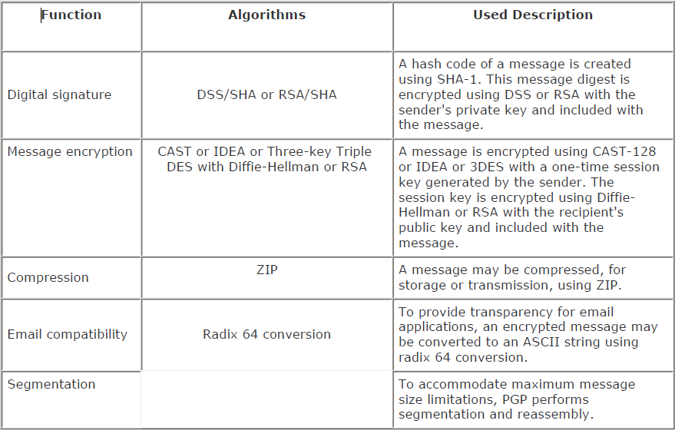
Summary of PGP Services

Slide 26
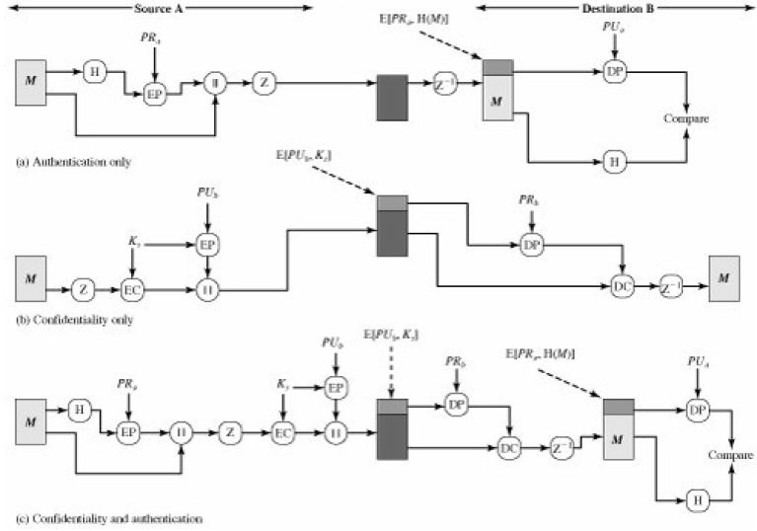
PGP Cryptographic Functions

Slide 27
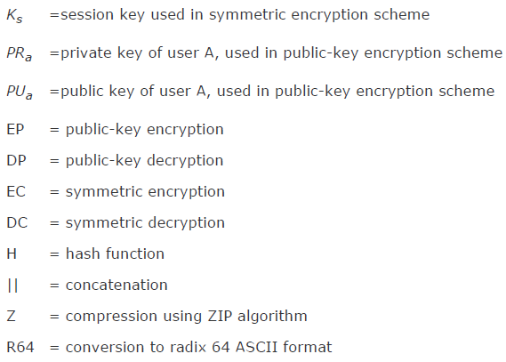
Notations used in PGP

Slide 28
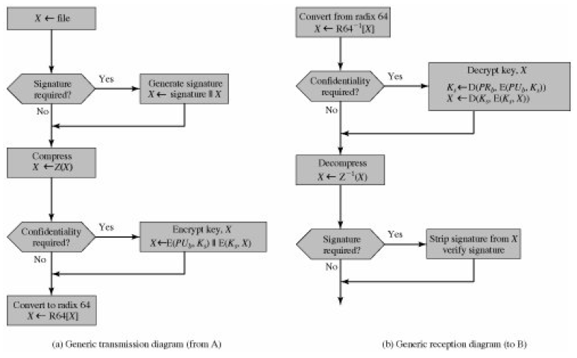
Transmission & Reception of PGP Messages

Slide 29
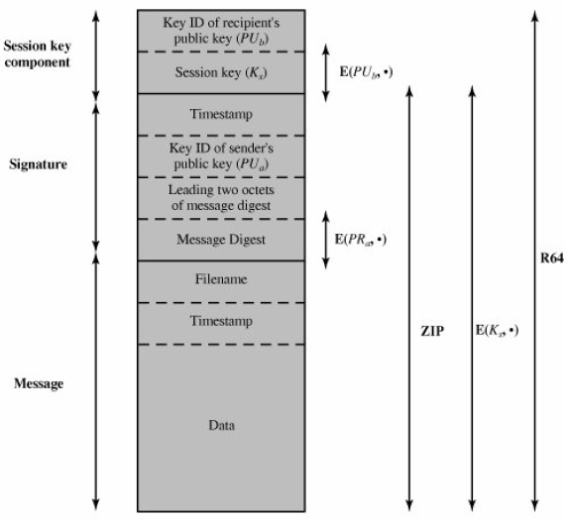
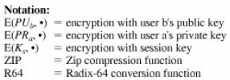
General Format of PGP Message (From A to B)

Slide 30
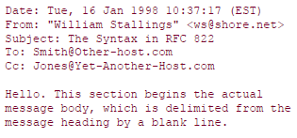
B.S/MIME
S/MIME (Secure/Multipurpose Internet Mail Extension) is a security enhancement to the MIME Internet email format standard, based on technology from RSA Data Security.
E-mail format standard, RFC 822 followed in S/MIME.
RFC 822 defines a format for text messages that are sent using electronic mail.
The envelope contains whatever information is needed to accomplish transmission and delivery.
The overall structure of a message that conforms to RFC 822 is very simple.

Slide 31
RFC822 & SMTP
Cannot transmit executable files or other binary objects.
Cannot transmit text data that includes national language characters because these are
Represented by 8-bit codes with values of 128 decimal or higher, and SMTP is limited to 7-bit ASCII.
Servers may reject mail message over a certain size.
Gateways that translate between ASCII and the character code EBCDIC do not use a
Consistent set of mappings, resulting in translation problems.
Gateways to X.400 electronic mail networks cannot handle nontextual data included in X.400 messages.
Do not adhere completely to the SMTP standards defined in RFC 821.

Slide 32
MIME Inclusions
MIME-Version: Must have the parameter value 1.0. This field indicates that the message conforms to RFCs 2045 and 2046.
Content-Type: Describes the data contained in the body with sufficient details.
Content-Transfer-Encoding: Indicates the type of transformation that has been used to represent the body of the message.
Content-ID: Used to identify MIME entities uniquely in multiple contexts.
Content-Description: A text description of the object with the body; this is useful when the object is not readable (e.g., audio data).

Slide 33
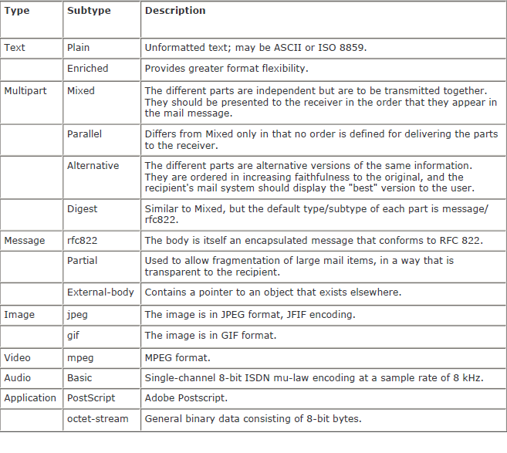
MIME Content Types

Slide 34
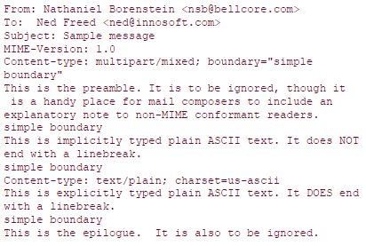
Four Subtypes of MIME
The multipart / mixed subtype is used when there are multiple independent body parts that need to be bundled in a particular order.
The multipart / parallel subtype, the order of the parts is not significant.
The multipart / alternative subtype, the various parts are different representations of the same information.
The multipart/digest subtype is used when each of the body parts is interpreted as an RFC 822 message with headers.

Slide 35
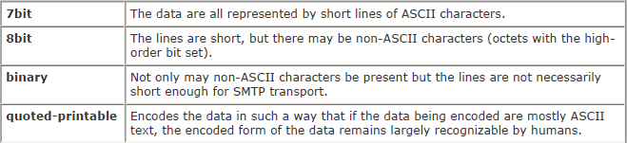

MIME Transfer Encoding

Slide 36
S/MIME Functionality
Enveloped data - consists of encrypted content of any type and encryption keys for one or more recipients.
Signed data - Digital signature is formed by taking the message digest of the content to be signed.
encrypting that with the private key of the signer (base64 encoding).
Clear-signed data - recipients without S/ MIME capability can view the message content, although they cannot verify the signature.
Signed and enveloped data - Signed-only and encrypted-only entities may be nested.
encrypted data may be signed and signed data or clear-signed data may be encrypted.

Slide 37
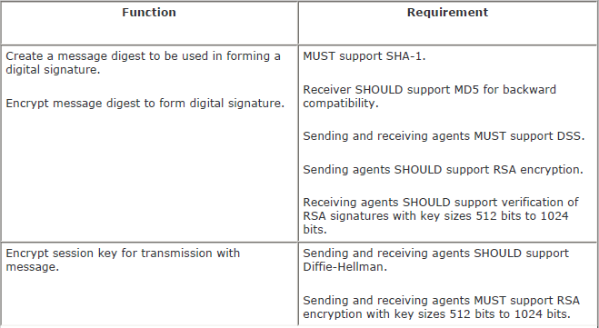
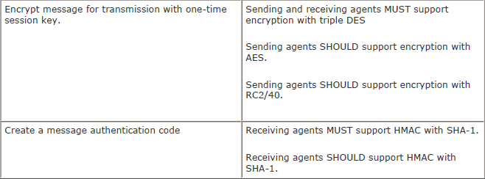
Cryptographic Algorithms Used in S/MIME

Slide 38
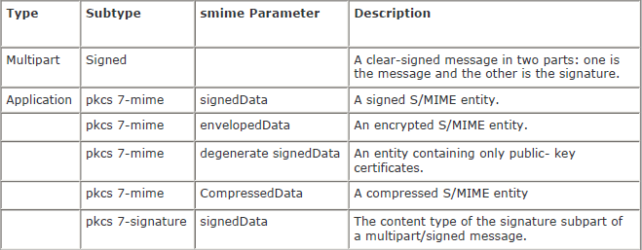
S/MIME Messages

Slide 39
4.IP Security
The IAB included authentication and encryption as necessary security features in the next-generation IP, which has been issued as IPv6.
Usable both with the current IPv4 and the future IPv6.
Applications of IPSec.
Secure branch office connectivity over the Internet.
Secure remote access over the Internet.
Establishing extranet and intranet connectivity with partners.
Enhancing electronic commerce security.

Slide 40
IPSec
General IP Security mechanisms provides
– authentication
– confidentiality
– key management
Applicable to use over LANs, across public & private WANs, & for the Internet

Slide 41
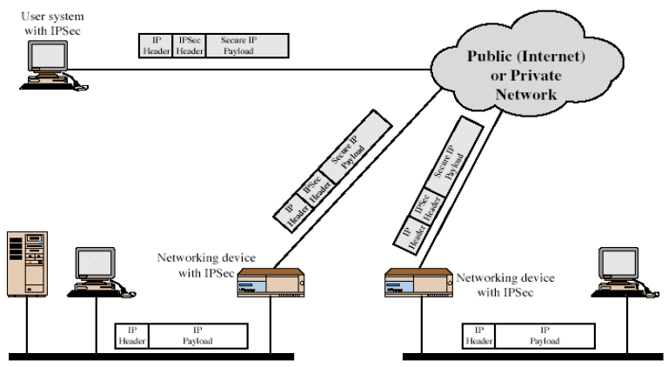
IP Security Scenario

Slide 42
Benefits of IPSec
In a firewall/router provides strong security to all traffic crossing the perimeter.
Is resistant to bypass.
Is below transport layer, hence transparent to applications.
Can be transparent to end users.
Can provide security for individual users if desired.

Slide 43
Routing Applications
IPSec can assure that
A router advertisement (a new router advertises its presence) comes from an authorized router.
A neighbor advertisement (a router seeks to establish or maintain a neighbor relationship with a router in another routing domain) comes from an authorized router.
A redirect message comes from the router to which the initial packet was sent.
A routing update is not forged.

Slide 44
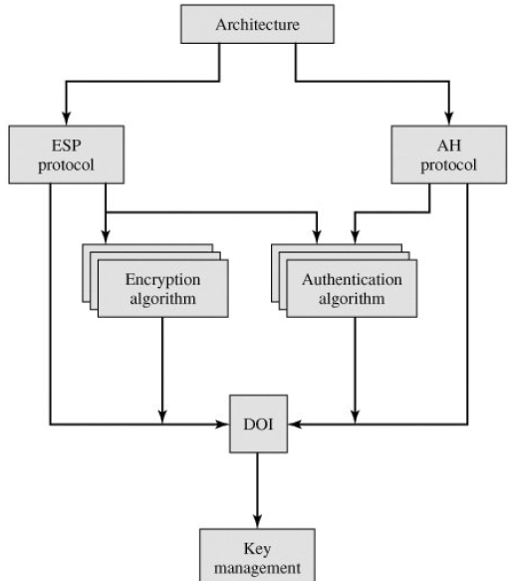
IP Security Architecture

Slide 45
IPSec Services
Access control
Connectionless integrity
Data origin authentication
Rejection of replayed packets (a form of partial sequence integrity)
Confidentiality (encryption)
Limited traffic flow confidentiality

Slide 46
Security Associations
A one-way relationship between sender & receiver that affords security for traffic flow.
Defined by 3 parameters:
– Security Parameters Index (SPI)
– IP Destination Address
– Security Protocol Identifier
Has a number of other parameters.
– seq no, AH & EH info, lifetime etc
Have a database of Security Associations.

Slide 47
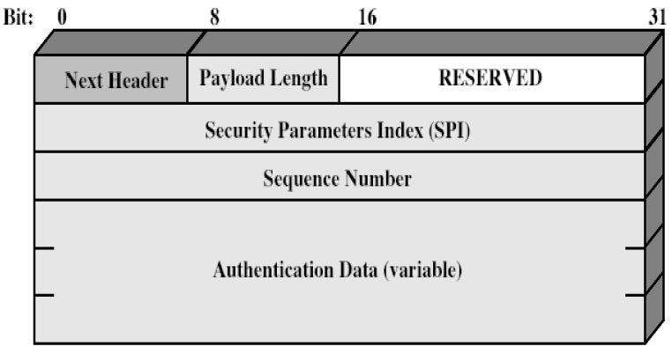
Authentication Header (AH)
Provides support for data integrity & authentication of IP packets
– end system/router can authenticate user/app.
– prevents address spoofing attacks by tracking sequence numbers.
Based on use of a MAC.
– HMAC-MD5-96 or HMAC-SHA-1-96.
parties must share a secret key.

Slide 48
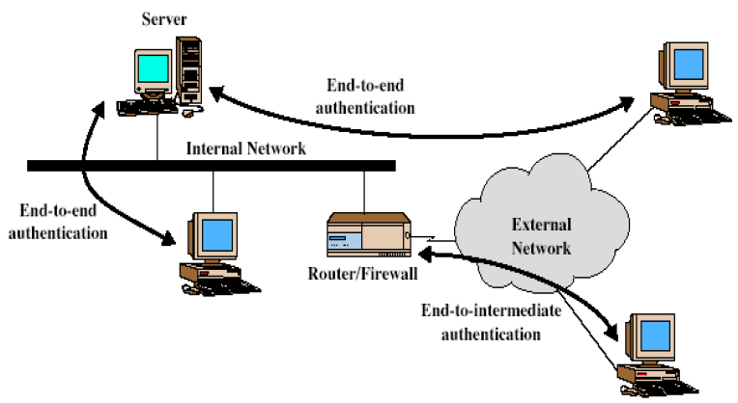
Transport & Tunnel Modes

Slide 49
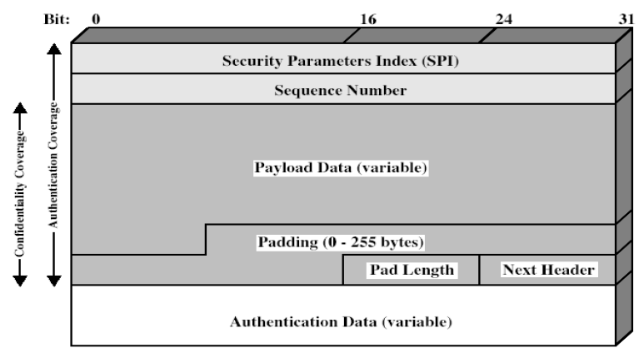
Encapsulating Security Payload (ESP)
Provides message content confidentiality & limited traffic flow confidentiality
Can optionally provide the same authentication services as AH
Supports range of ciphers, modes, padding
– incl. DES, Triple-DES, RC5, IDEA, CAST etc
– CBC most common
– pad to meet blocksize, for traffic flow

Slide 50
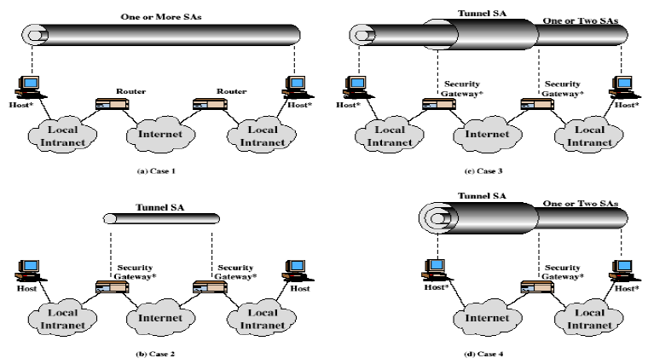
Combining Security Associations
SA’s can implement either AH or ESP
To implement both need to combine SA’s
– form a security bundle
Have 4 cases

Slide 51
Key Management
Handles key generation & distribution
Typically need 2 pairs of keys
– 2 per direction for AH & ESP
Manual key management
– sysadmin manually configures every system
Automated key management
– automated system for on demand creation of keys for SA’s in large systems.
– has Oakley & ISAKMP elements

Slide 52
Oakley
A key exchange protocol
Based on Diffie-Hellman key exchange
Adds features to address weaknesses
– cookies, groups (global params), nonces, DH key exchange with authentication
Can use arithmetic in prime fields or elliptic curve fields

Slide 53
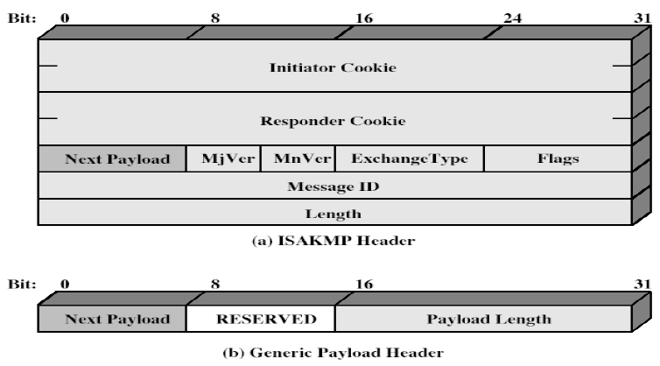
ISAKMP
Internet Security Association and Key Management Protocol
Provides framework for key management.
Defines procedures and packet formats to establish, negotiate, modify, & delete SAs.
Independent of key exchange protocol, encryption alg, & authentication method.

